Slide 1
Programming
Frontend and Backend:
Hants Williams, PhD, RN

Slide 2
Software stack (web): Frontend

Slide 3
FRONTEND
APIs
BACKEND
Front end: The software development that happens on the user-side. When you interact with buttons, forms, input boxes, images, banners and other elements of a webpage on a browser, all of this falls under the purview of the front-end developer.

Slide 4
Networking

Slide 5
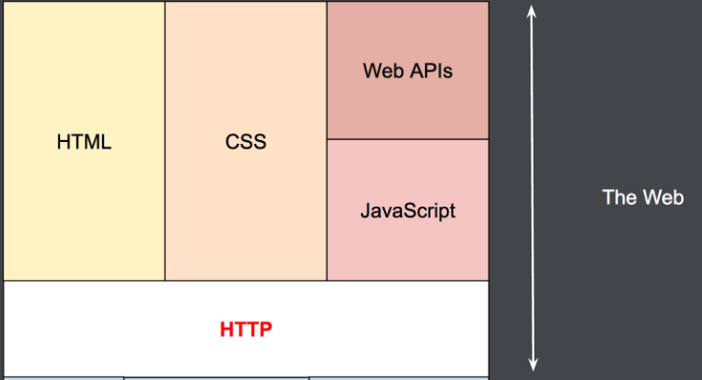
Frontend Simplified

Slide 6
How do computers talk to one another?
Networking basics…

Slide 8
Nurse workstation
Hospital EMR
ISP
COX
ISP
AT&T
ISP
Comcast

Slide 11
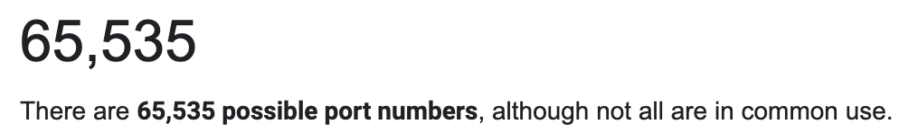
Types of applications:
:80 → Non-secure web app
:443 → Secure web app
:25 → Email

Slide 12
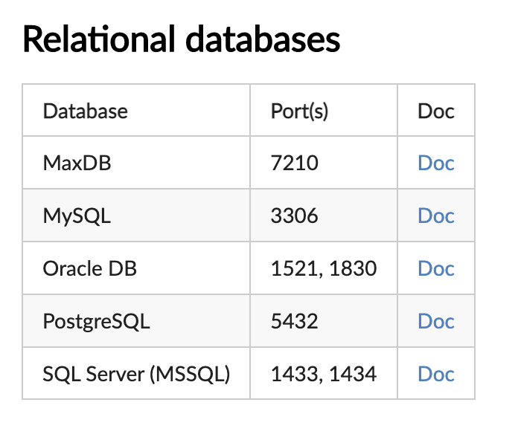
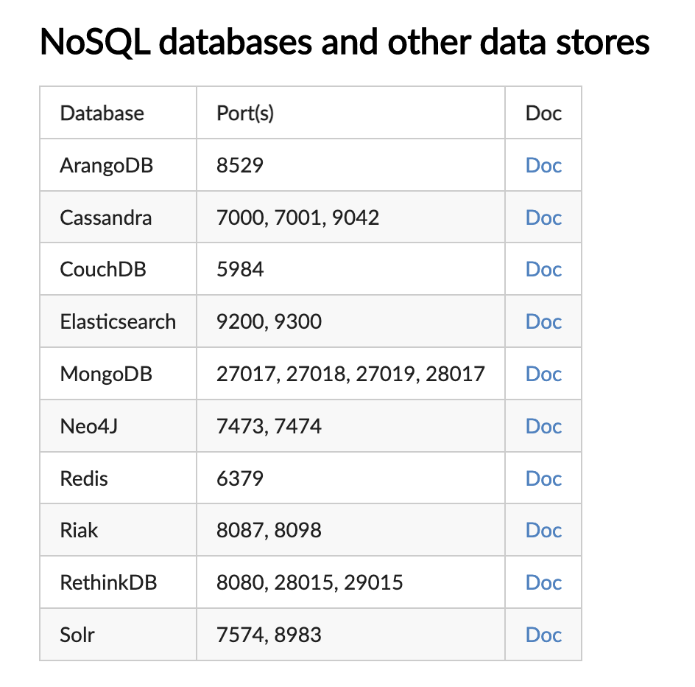
https://secbot.com/docs/ports/common-ports

Slide 13
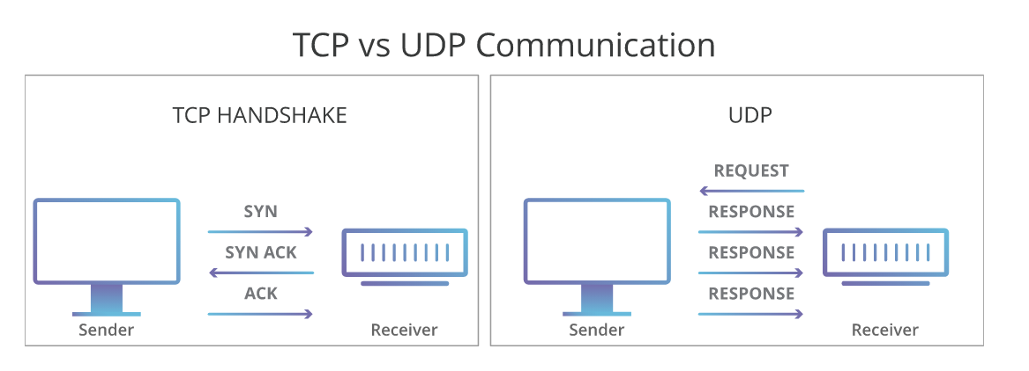
Transmission control protocol (TCP) and Use Datagram Protocol (UDP)
Data units include details such as: — the IP addresses of the respective sender and the receiver, the data that is to be transferred, multiple configurations, and the trailer (data which refers to the end of the packet).
TCP: Establishes connection between client/server before sending data
UDP: Does not establish connect before hand; is ‘connectionless’
Both TCP and UDP help in converting the data into smaller units referred to as units.

Slide 14
Metadata
Sequence number – A device initiating a TCP connection must choose a random initial sequence number, which is then incremented according to the number of transmitted bytes.
Acknowledgment number – The receiving device maintains an acknowledgment number starting with zero. It increments this number according to the number of bytes received.
TCP data offset – This specifies the size of the TCP header, expressed in 32-bit words. One word represents four bytes.
Reserved data – The reserved field is always set to zero.
Control flags – TCP uses nine control flags to manage data flow in specific situations, such as the initiating of a reset.
Window size TCP checksum – The sender generates a checksum and transmits it in every packet header. The receiving device can use the checksum to check for errors in the received header and payload.
Urgent pointer – If URG control flag is set, this value indicates an offset from the sequence number, indicating the last urgent data byte.
Metadata
Data

Slide 15
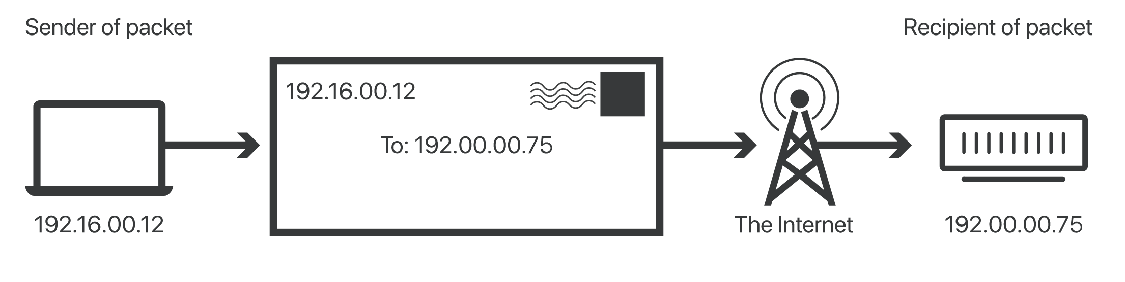
An IP address is a unique identifier assigned to a device or domain that connects to the Internet.
The fourth version of IP (IPv4 for short) was introduced in 1983

Slide 16
Private IP - set by router / dynamically
Public IP: set by ISP

Slide 17
IP data

Slide 18
IP packet

Slide 19
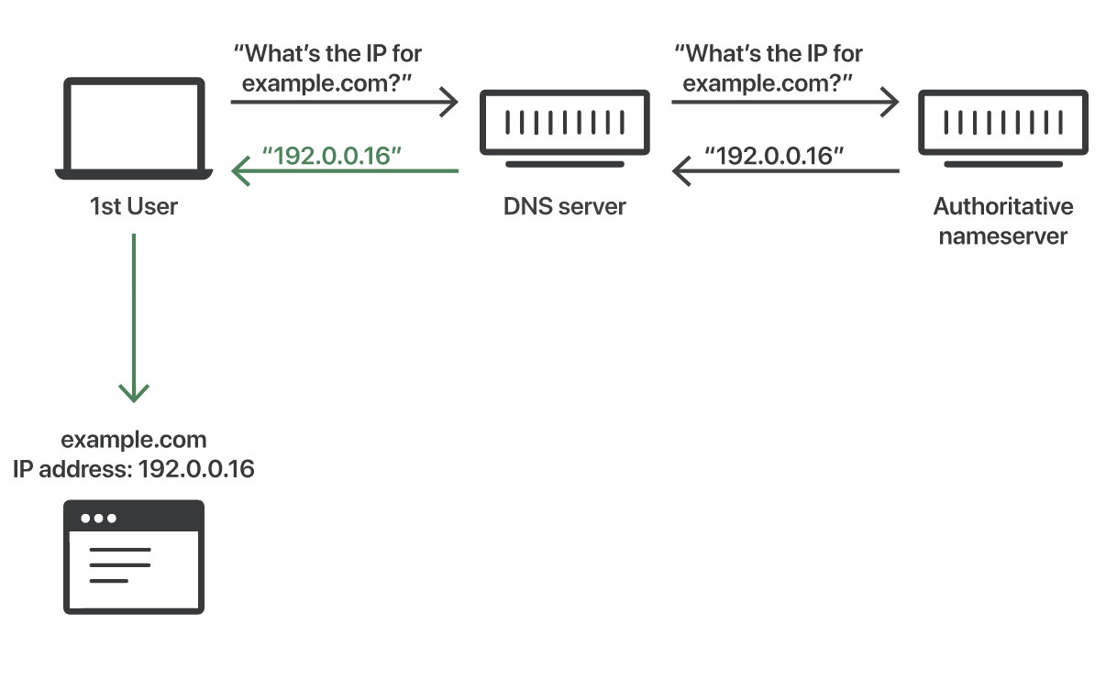
Simplifying the communication
DNS: Domain Name Service (Port 53)

Slide 20

Development Frontend Basics
Web
TCP :80 :443
stonybrook.edu
ping???
TCP :53

Slide 21
Application (frontend) layer

Slide 23
HTTP: Hypertext Transfer Protocol
HTTP stands for hypertext transfer protocol and is used to transfer data across the Web.
The client makes a request and the server responds.

Slide 24
http is the transfer protocol that transfer the resource (web page,image,video etc) from the server to the client.

Slide 25
Primary Components of HTTP:
HTTP version
URL
Method
Request headers
Body

Slide 26
HTTP versions
In 1989, Tim Berners-Lee invented HTTP. HTTP/1.1 was its 1st standardized version that was available for use in the year 1997 for the end-users. HTTP/1 was known to have poor response time. With websites becoming more resource-intensive, the protocol was losing its efficiency. It progressively became essential to minimize latency and boost page load speeds.
Google looked into these problems. And as expected, SPDY - an experimental project to end troubles with HTTP/1.x – was put into trial in the year 2010.

Slide 27
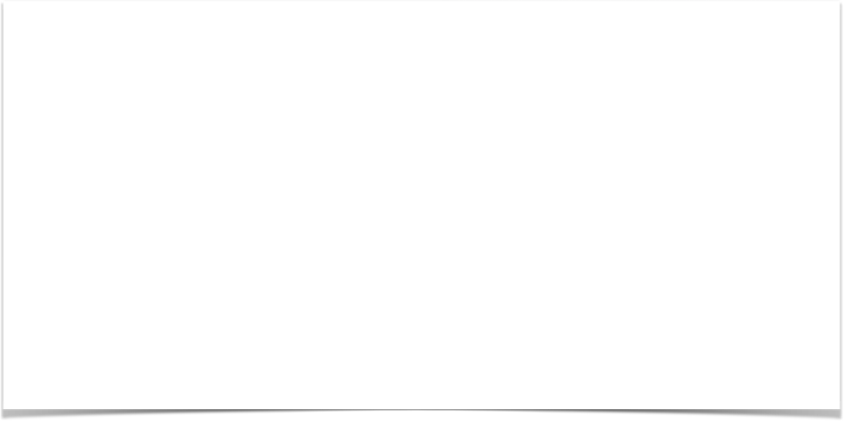
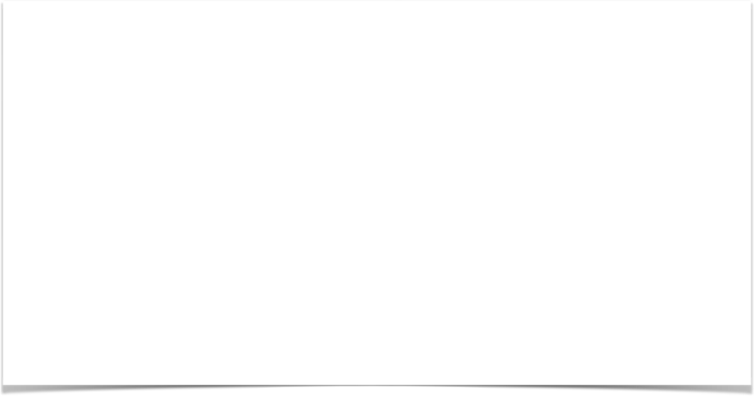
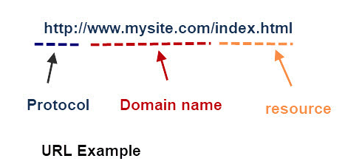
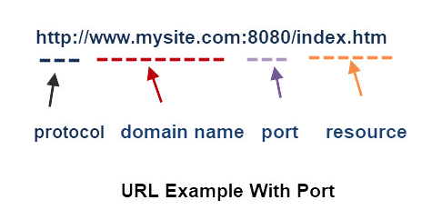
HTTP/HTTPS and URL

Slide 28
Methods (CRUD)

Slide 29
Request headers
HTTP headers let the client and the server pass additional information with an HTTP request or response.
An HTTP header consists of its case-insensitive name followed by a colon (:), then by its value.
Accept-Language: en-US,en;q=0.5
Accept: text/html;

Slide 30
Body
Text
Javascript
JSON
HTML
XML
Form-Data
x-www-form-urlencoded

Slide 31
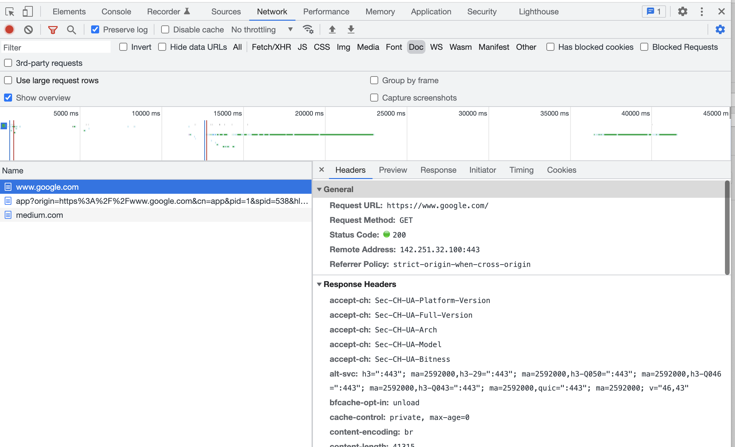
Response

Slide 32
Response
Response Status codes are split into 5 groups each group has a meaning and a three digit code.
1xx – Informational
2xx – Successful
3xx -Multiple Choice
4xx– Client Error
5xx -Server Error
https://developer.mozilla.org/en-US/docs/Web/HTTP/Status

Slide 33
Example in python…get
import requests
url = "http://www.google.com"
myHeaders = {"content-type": "text"}
response = requests.get(url, headers=myHeaders)
print("Status Code", response.status_code)
print("JSON Response ", response.json())

Slide 34
Example in python…post
import requests
url = "https://httpbin.org/post"
data = {
"id": 1001,
"name": "hants",
"passion": "coding",
}
response = requests.post(url, json=data)
print("Status Code", response.status_code)
print("JSON Response ", response.json())

Slide 35
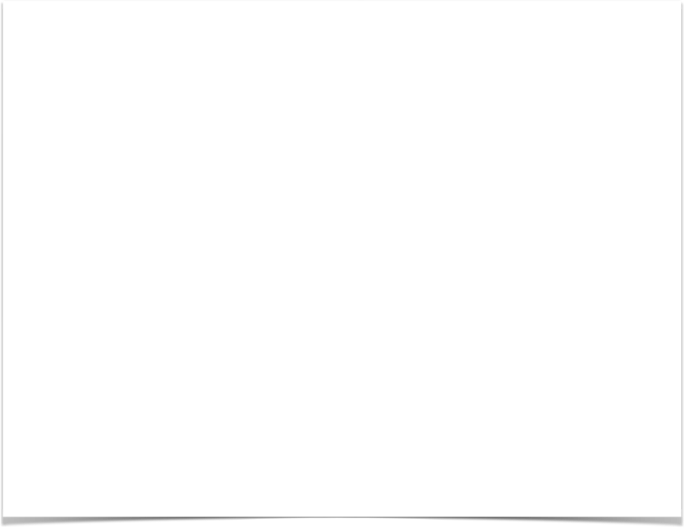
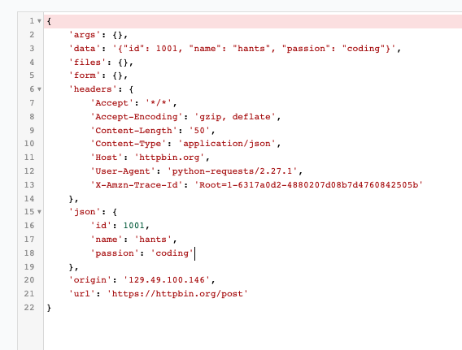

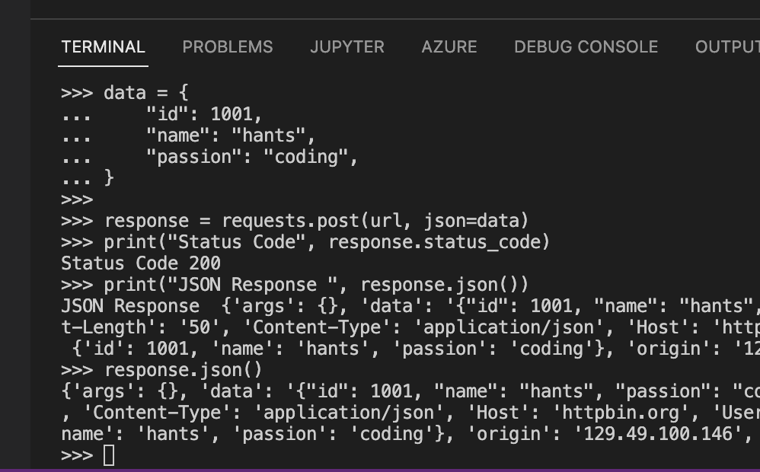
Pretty preview
jsonlint.com

Slide 36
Frontend Technologies

Slide 37
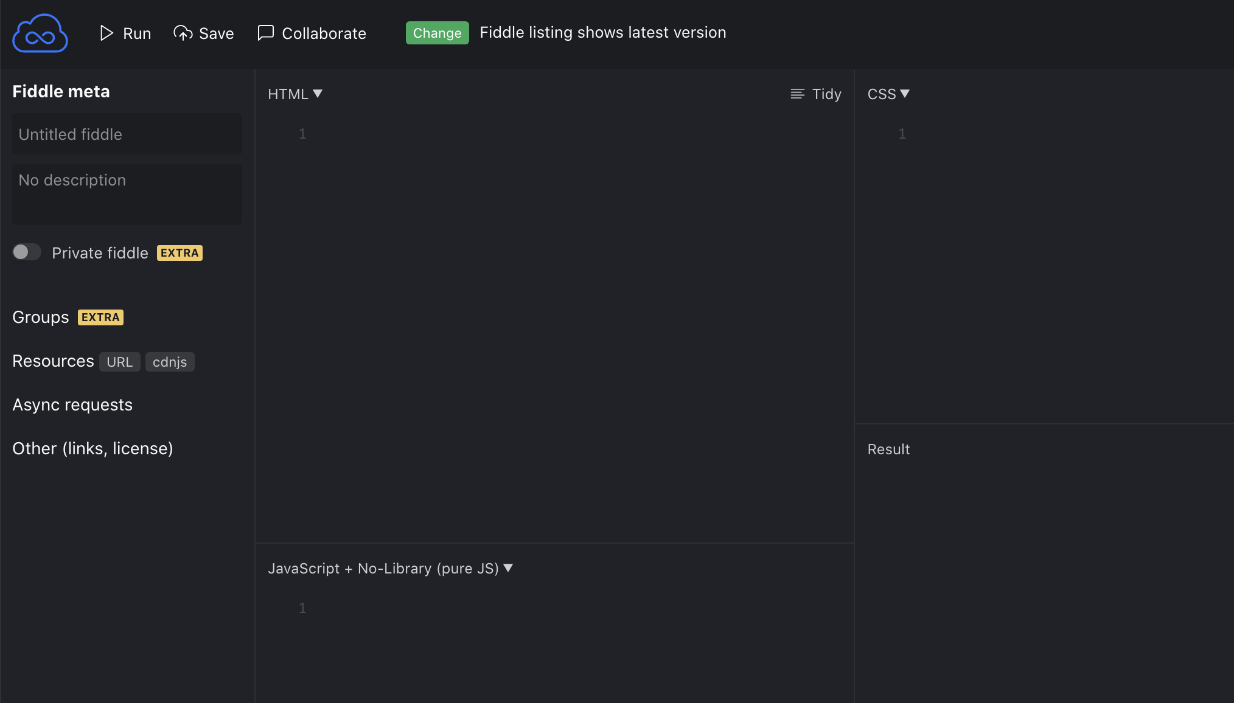
VS Code
https://code.visualstudio.com/download
https://jsfiddle.net/

Slide 39
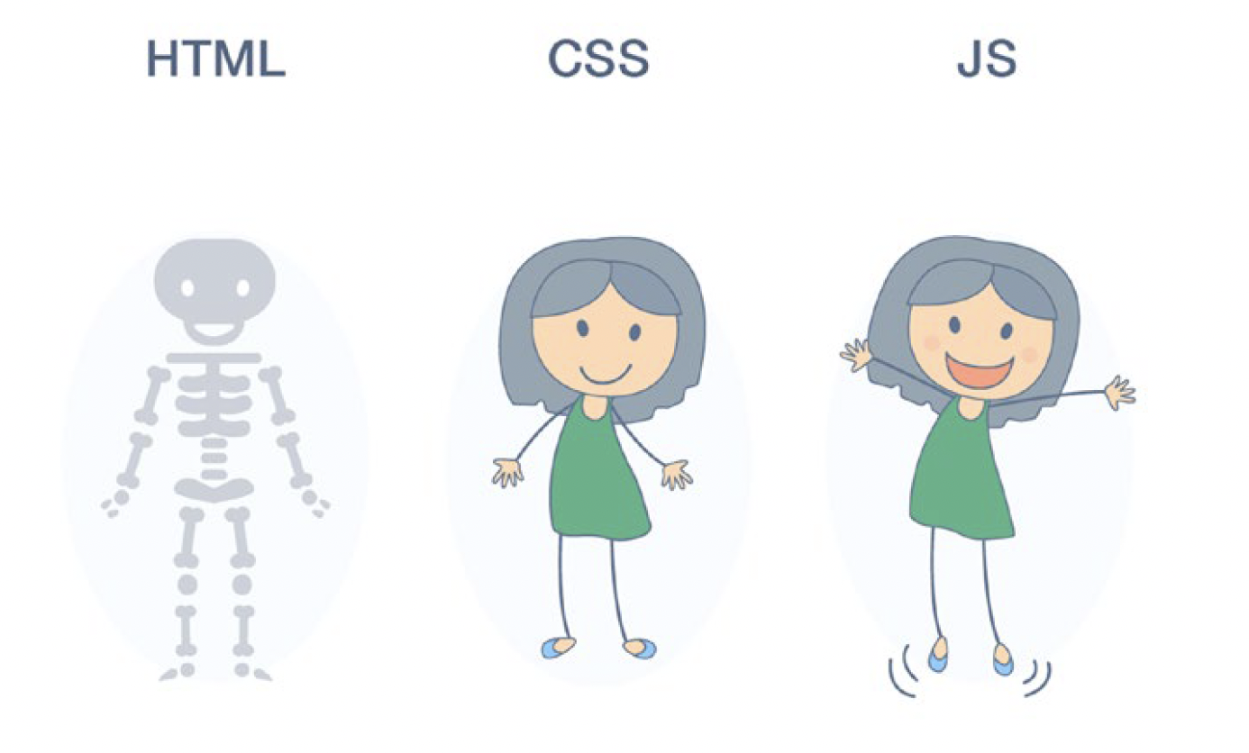
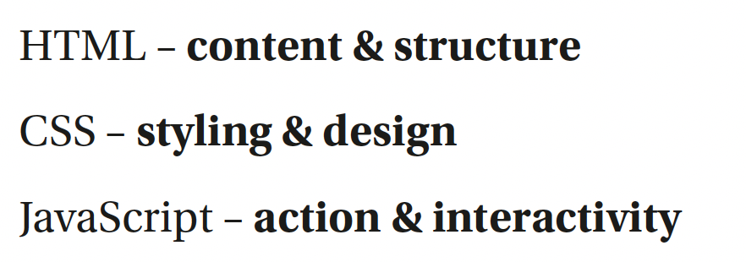

Slide 41
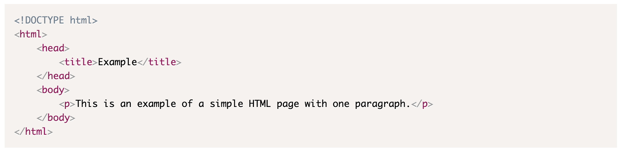
Basic HTML
HTML (Hypertext Markup Language)
HTML structures content using tags.
A tag helps define an element on a page and render content on the browser.
https://www.w3schools.com/TAGS/default.ASP

Slide 42
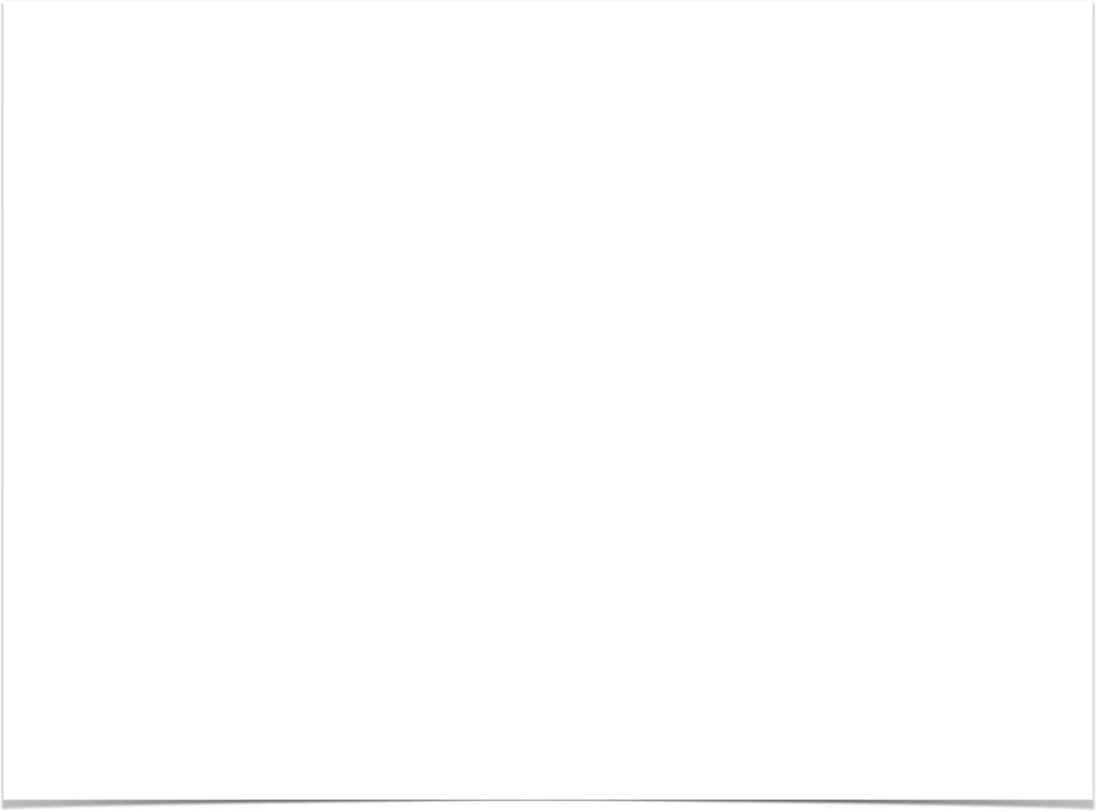
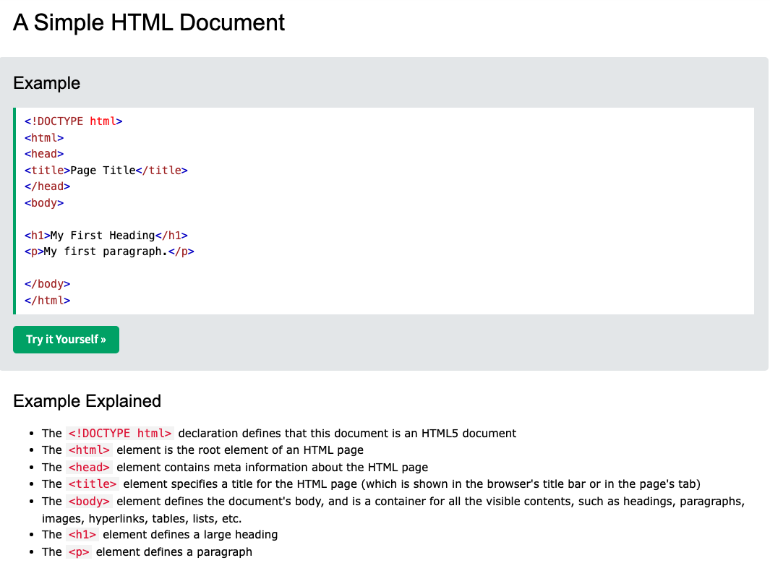
W3Schools {intro, basic, styles, layout}

Slide 43
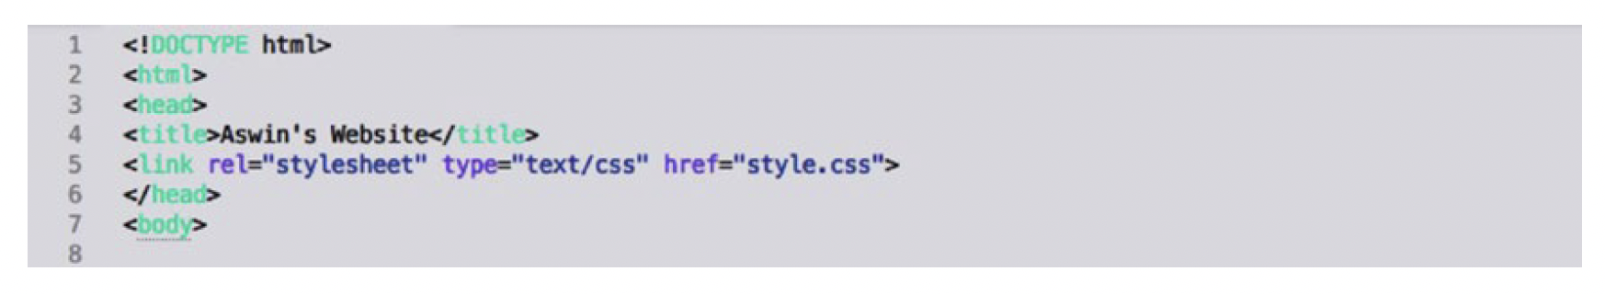
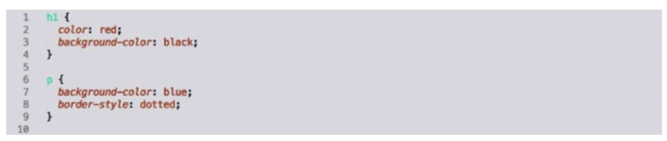
Styling HTML
CSS
https://www.w3schools.com/css/default.asp

Slide 44
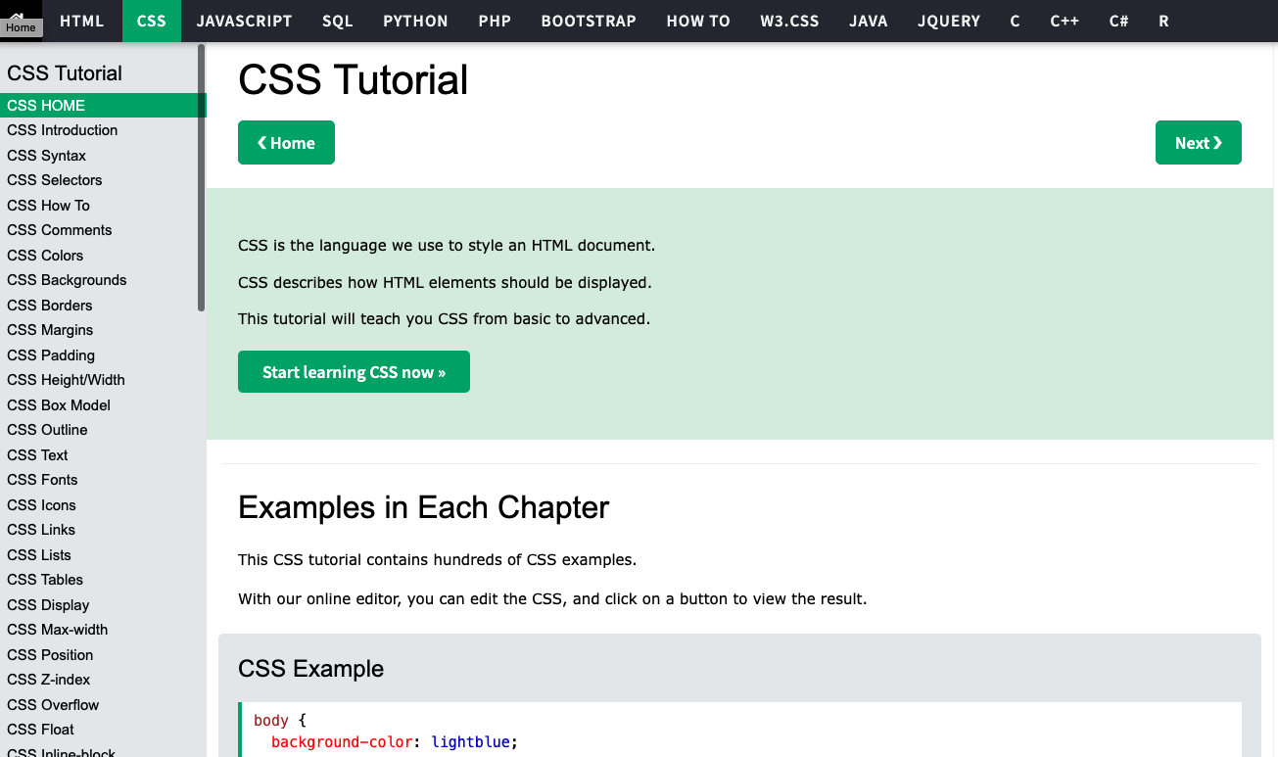
W3Schools {intro, syntax, selectors, how to}

Slide 45

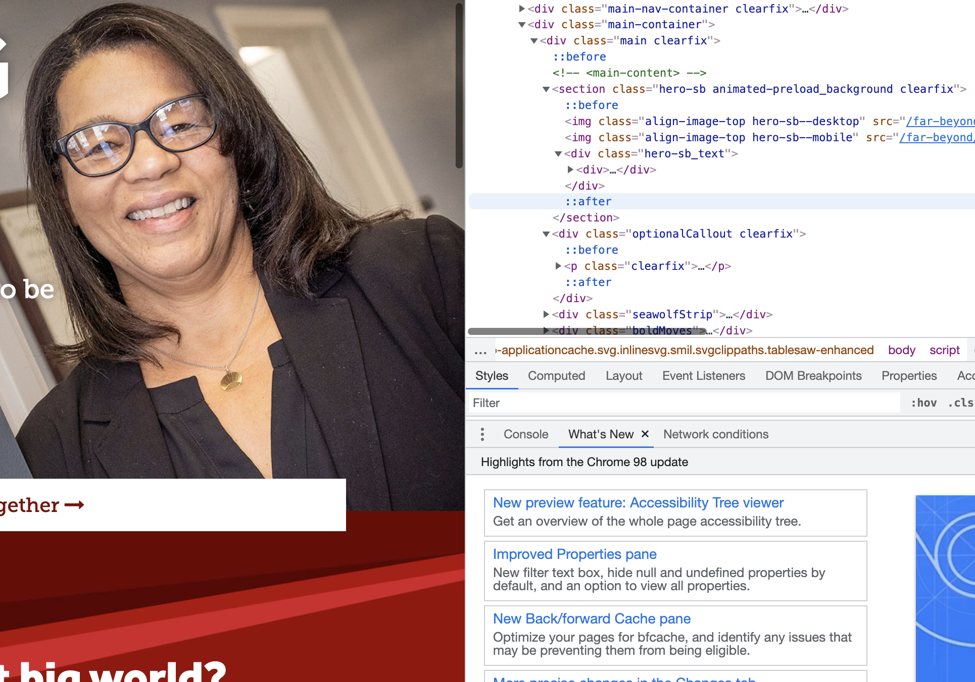
Finding examples online: 1. Raw webpage

Slide 46
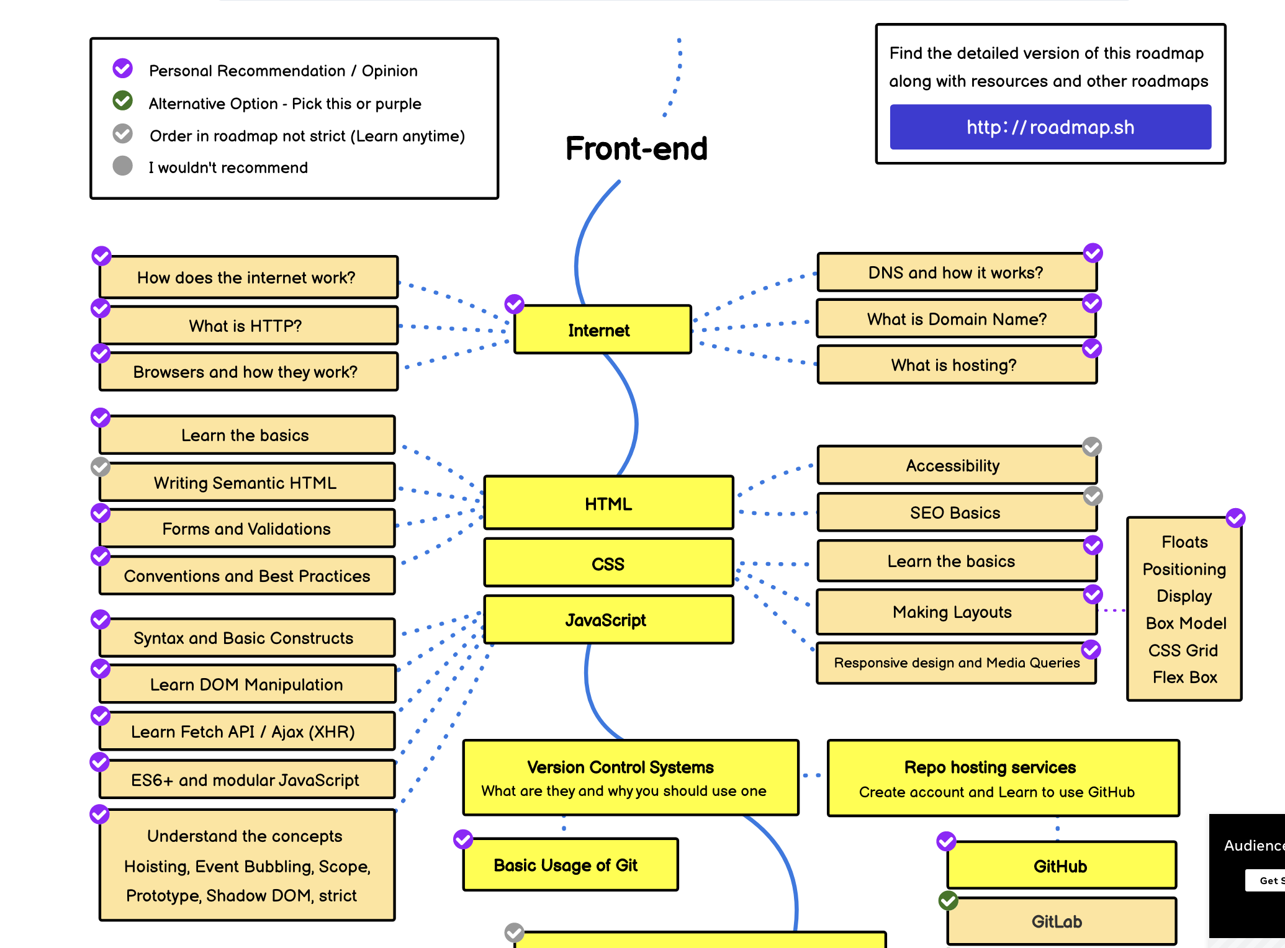
https://roadmap.sh/frontend

Slide 47
Flask and Python

Slide 48
What is flask? (pip install flask)
A web framework for python
Flask is a web framework. This means flask provides you with tools, libraries and technologies that allow you to build a web application.
This web application can be some web pages, a blog, a wiki or go as big as a web-based calendar application or a commercial website.
https://shell.cloud.google.com/

Slide 49
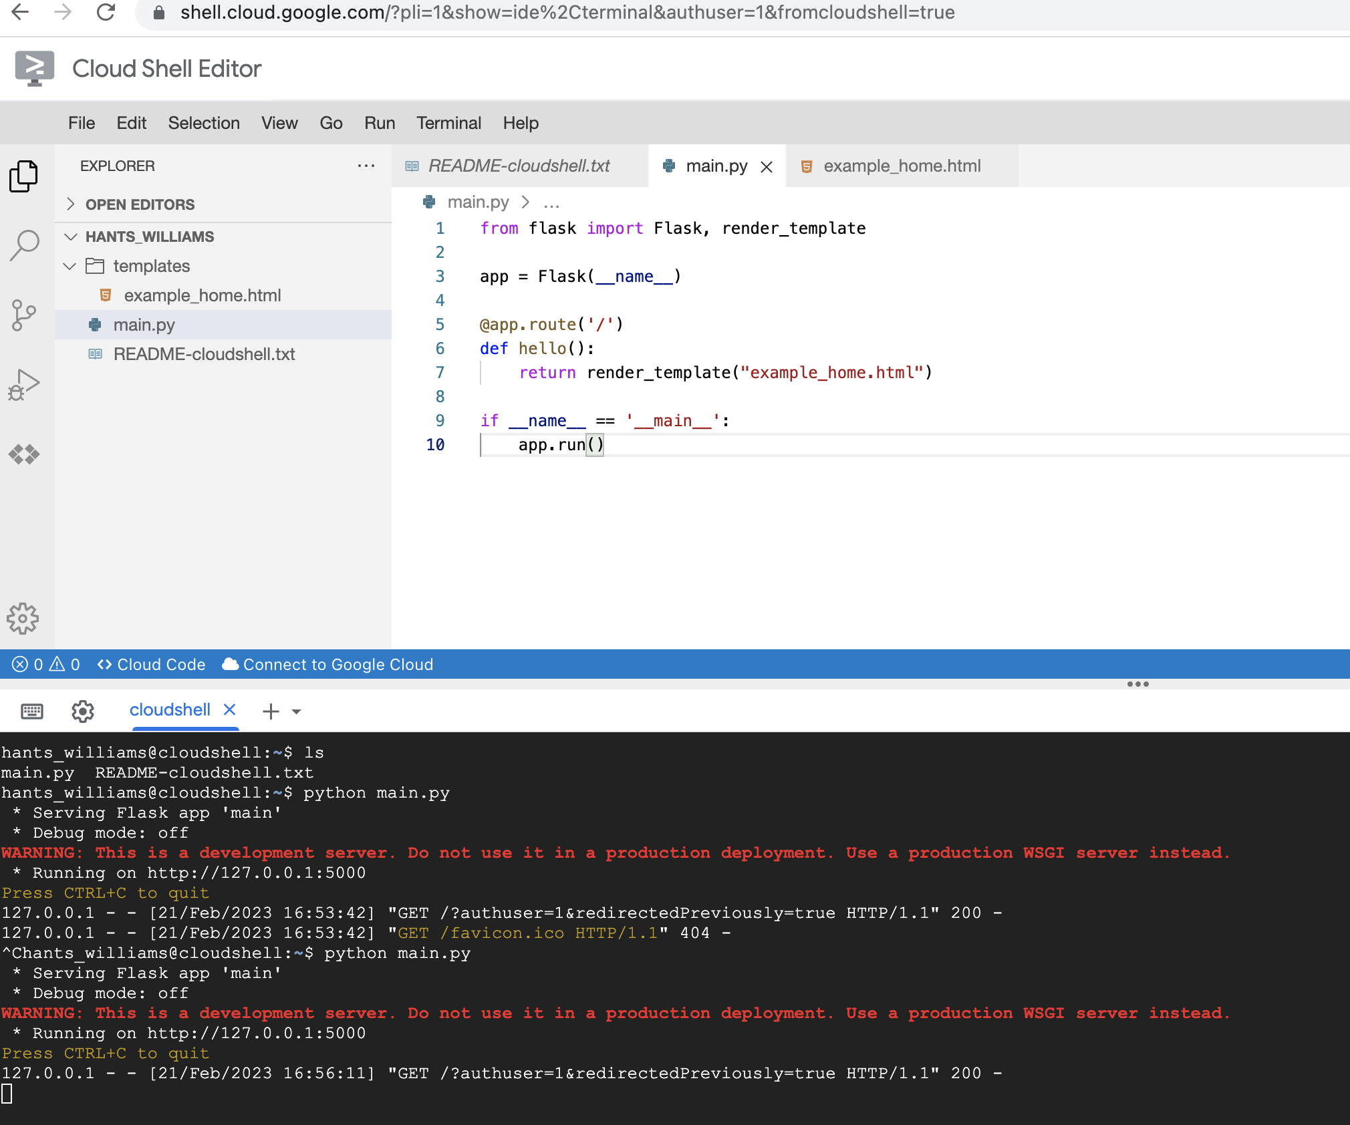
https://shell.cloud.google.com/

Slide 50
Creating the HTML page
Create basic HTML page called ‘index.html’ and save the file to a folder called ‘templates’, which is a special folder that flask knows to look for HTML files within
<html>
<head>
</head>
<body>
<h1>Home page</h1>
<p>My first Flask site</p>
</body>
</html>
my-flask-app
├── static/
│ └── main.css
├── templates/
│ ├── index.html
├── app.py

Slide 51
Python Code
First you must import render_template from the Flask module. Change your first line to this:
from flask import Flask, render_template
app = Flask(__name__)
@app.route('/')
def index():
return render_template('index.html')
my-flask-app
├── static/
│ └── main.css
├── templates/
│ ├── index.html
├── app.py

Slide 52
HTML in Python/Flask: JINA
Adding dynamic values/variables --> passing from python to HTML
app.py file
home.html file
From flask import Flask, render_template
app = Flask(__name__)
@app.route('/')
def home():
"""Landing page."""
return render_template(
'home.html’,
title=“Patient Portal",
description=“This is where you get your data!”
)
<div class="container">
<h1> {{title}} </h1>
<p> {{description}} </p>
</div>

Slide 53
Adding CSS
Create a .css file that contains the below code. Create a folder called static, under your working folder. Name the file main.css and store it in a folder called ‘static’
body {
background: Linen;
margin-top: 50px;
margin-left: 100px;
}
p {
font-family: Georgia, serif;
font-size: 1.2em;
color: DarkSlateGray;
}
h1 {
font-family: Verdana, Geneva, sans-serif;
font-size: 2.5em;
color: FireBrick;
}
my-flask-app
├── static/
│ └── main.css
├── templates/
│ ├── index.html
├── app.py

Slide 54
Update HTML page to bring in CSS
You will also need to edit your html file to include the CSS file. Add the extra line in the head section like this:
<html>
<head>
<link rel="stylesheet" href='{{ url_for('static', filename=main.css') }}' />
</head>
<body>
<h1>Home page</h1>
<p>My first Flask site</p>
</body>
</html>
my-flask-app
├── static/
│ └── main.css
├── templates/
│ ├── index.html
├── app.py

Slide 55
If you want more now <
Flask Mega Tutorial:
https://blog.miguelgrinberg.com/post/the-flask-mega-tutorial-part-i-hello-world
Coursera: https://www.coursera.org/projects/python-flask Udemy:
https://www.udemy.com/course/python-flask-for-beginners/

